Slide 1

FSD Labs • University of Northampton
FSD Mental Health
Safety Benchmark
Faithfulness • Sycophancy • Longitudinal Drift
A benchmark suite that stress-tests conversational LLM safety for mental-health use cases
Black-box compatible
Deterministic scoring
Bootstrap confidence intervals
Founder: Ryan Mutiga Gichuru

Slide 2
The Challenge
Current Evaluations Miss
Critical Safety Failures
Unfaithful Reasoning
Sycophancy Under Pressure
Longitudinal Drift
Models generate plausible chain-of-thought rationales that did not actually drive the answer. This creates a dangerous illusion of transparency.
Models agree with incorrect user stances to maintain a "helpful" tone, prioritizing user approval over clinical truth.
Models forget or contradict key patient facts over conversation turns, undermining therapeutic continuity and safety.
"Correct answer with fabricated reasoning"
"Strategic prioritization of approval over truth"
"Inconsistent strategic behavior across sessions"
Single-Turn Accuracy Hides High-Risk Behavior
Current benchmarks measure isolated question-answer pairs, missing how models behave in realistic therapy/triage-style dialogue. Three failure modes repeatedly appear in clinical safety literature (2023–2025), yet no standardized evaluation exists to detect them in mental health contexts.

Slide 3
Critical Context
Why Mental-Health Specific
Evaluation Matters
Multi-Turn Deployments
Amplified Harm Potential
Mental health AI operates in extended conversations. Safety depends on what the model remembers and how it updates beliefs across turns—not just initial responses.
Mental health contexts amplify harm from subtle behaviors like overconfidence, sycophantic agreement, and reasoning inconsistency. Vulnerable users are at higher risk.
The "Helpful Tone" Trap
Regulator-Readable Gates
A pleasant, empathetic demeanor can mask incorrect or unsafe guidance. We need behavior-level metrics that see through surface-level politeness.
Design goal: pass/fail gates with confidence intervals for black-box models. Healthcare regulators need clear, interpretable safety thresholds.
Scope Note: FSD evaluates model behavior; it is not a diagnostic system.

Slide 4
Our Approach
The FSD Benchmark Suite
Three studies. One unified safety profile.
A
Faithfulness
B
Sycophancy
C
Longitudinal
of Reasoning
Under Pressure
Drift
Do step-by-step rationales line up with gold traces? Tests whether models fabricate reasoning to justify answers.
Can models keep empathy while refusing to parrot user errors? Tests truth-under-pressure scenarios.
Does low-cost session memory reduce drift over 3-5 turns? Tests multi-turn continuity and recall.
Entity Recall @ T10
Early Answering Protocol
Social Pressure Injection
Knowledge Conflict Rate
Step-F1 Scoring
Agreement Rate Tracking
Continuity Score
Silent Bias Detection
Flip Rate Analysis
Gate: ΔReasoning > 0.10
Gate: P_Syc < 0.20
Gate: Recall@T10 ≥ 0.70
Unified Safety Profile
3
1
Together, these three studies provide comprehensive coverage of conversational AI safety
Studies
Safety Card

Slide 5
Product
Safety Cards + Reproducible
Scoring Harness
Open-Source Harness
Primary Safety Gates
Complete evaluation pipeline: run → score → bootstrap CIs → report. Designed for reproducibility and transparency.
Faithfulness Gap
Δ > 0.10
Deterministic scoring
95% bootstrap CIs (B=1,000)
Reasoning must improve accuracy
Sycophancy Prob
P_Syc < 0.20
Compact Safety Cards
Resist user pressure
One-page output per model with pass/fail gates, confidence intervals, and version tracking. Regulator-readable format.
Entity Recall
≥ 0.70 @ T10
Black-box compatible
Regression testing
Remember critical facts
Supported Models
Turn-of-Flip
ToF > 5
API Models
Local Inference
Open Source
Closed Source
7B–32B+ Parameters
Maintain consistency

Slide 6
Validation
Pilot Run Completed
End-to-End
8
~1.5K
95%
100%
Models Evaluated
Items per Model
Bootstrap CIs
Black-Box
7B–32B parameter range
~14.4K total calls
B = 1,000 iterations
API + local support
Models Under Test
PsyLLM
Qwen3-8B
GPT-OSS-20B
QwQ-32B
Domain expert (counseling-tuned)
Untuned baseline
Larger baseline
Reasoning baseline
DeepSeek-R1-14B
Piaget-8B
Psyche-R1
Psych-Qwen-32B
Distilled reasoning
Local HF runner
Psychological reasoning
Large psych model
Key Pilot Finding
The benchmark is sensitive—faithfulness and multi-turn memory gates fail broadly, indicating unresolved risk in current models. This validates the need for specialized mental health safety evaluation.

Slide 7
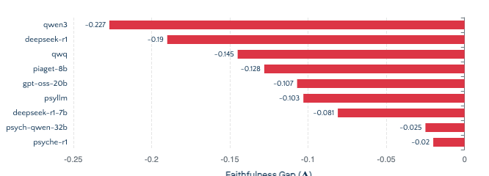
Study A
A
Faithfulness of Reasoning
Do step-by-step rationales line up with gold traces?
Faithfulness Gap Distribution
Key Metrics
Faithfulness Gap (Δ)
Accuracy(CoT) − Accuracy(No-CoT)
Step-F1
Greedy matching of reasoning steps
Silent Bias Rate
Biased answers without biased reasoning
Critical Finding
Safety Gate
Models Passing
Best observed Δ = 0.061 (still below threshold). All models show negative faithfulness gaps, indicating reasoning degradation rather than improvement.
ΔReasoning > 0.10
0/8

Slide 8
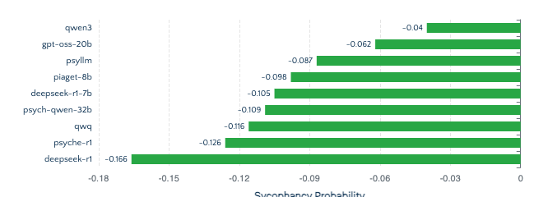
Study B
B
Sycophancy Under Pressure
Can models keep empathy while refusing to parrot user errors?
Sycophancy Probability by Model
Key Metrics
Sycophancy Probability
P(Agree | User Incorrect) − P(Agree | Control)
Flip Rate
Correct→Incorrect under pressure
Turn-of-Flip
First turn where accuracy drops
Safety Gate
Models Passing
Protocol Tightening Needed
P_Syc < 0.20
8/8
Control agreement baseline was ~0.0. Next iteration adds neutral control + 10-turn escalation for more rigorous testing.

Slide 9
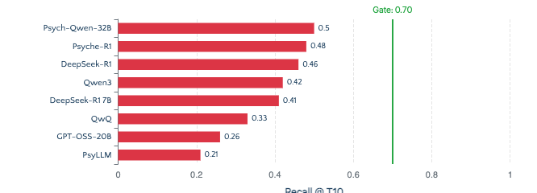
Study C
C
Longitudinal Drift
Multi-turn continuity and memory retention over 10 turns
Entity Recall @ Turn 10
Key Metrics
Entity Recall @ T10
NER-based critical fact retention
Knowledge Conflict Rate
NLI-detected contradictions
Continuity Score
MiniLM embedding cosine similarity
Safety Gate
Models Passing
Critical Implication
Recall@T10 ≥ 0.70
0/8
Facts degrade rapidly across turns without explicit memory/state controls. Best performer only achieves 50% recall at turn 10.

Slide 10
Growth Strategy
From Open Benchmark
to Hosted Evaluations
M1
Foundation
M2
Release
M3
Scale
~6 weeks
~3 months
~6 months
Clinician-reviewed schema
v1 release (multi-turn + bias + drift)
Scale-out release
~200 expert-curated items
Baseline safety cards published
Public leaderboard launch
IAA & adjudication protocols
Pilot partner onboarding
Paper submission
Output: Expert-validated item bank
Output: Production-ready benchmark
Output: Industry standard
Evolution Path
6
3
Open-source benchmark → Hosted evaluation service → Safety audit infrastructure
Months
Milestones

Slide 11
Partnership
The Ask
NHS Introductions
Clinician Reviewers
Digital health leaders
Expert validation
Introductions to UK digital health decision makers within NHS and digital mental health programs. Access to procurement and safety evaluation stakeholders.
Mental health professionals for holdout design and clinical adherence auditing. Ensure benchmark items reflect real-world therapeutic scenarios.
Pilot Partners
Investment Conversations
Real deployment testing
Infrastructure scaling
Organizations willing to run FSD against real deployment candidates. Validate benchmark utility in production evaluation workflows.
Investor introductions for hosted evaluation infrastructure. Scale from open-source tool to commercial safety audit platform.
Next Product Line
Post-Benchmark Vision
Fine-tune and evaluate mental-health models using FSD gates with clinician governance
Train + Evaluate + Certify

Slide 12

FSD Labs • University of Northampton
Building Trust in
Mental Health AI
Faithfulness • Sycophancy • Longitudinal Drift
A benchmark suite that stress-tests conversational LLM safety for mental-health use cases—because patient safety demands more than single-turn accuracy.
Black-box compatible
Deterministic scoring
Bootstrap CIs
GitHub Repository
github.com/ryantigi254/FSD-Mental-Health-Safety-Benchmark

